Slide 1
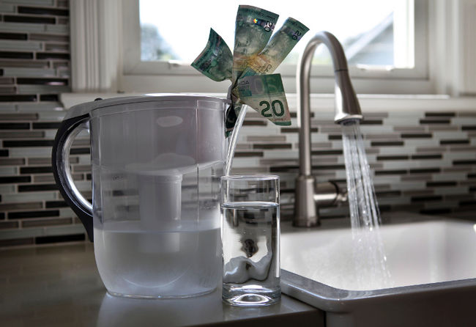
Water Privatization

Slide 2
History
England in 1700 they were the first ones to privatization water because they taxed the bigger richer cities and used that money to build up the poorer smaller areas. Also Germany used it in 1952 to repay the 35 million dollars that they owed to other countries for starting the war.
Now we abuse the privatization of water because we don’t use it to build up our countries, we do it for the money and 30% of the bottled water that we drink isn't even ours.

Slide 3
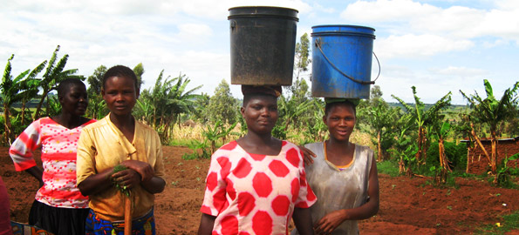
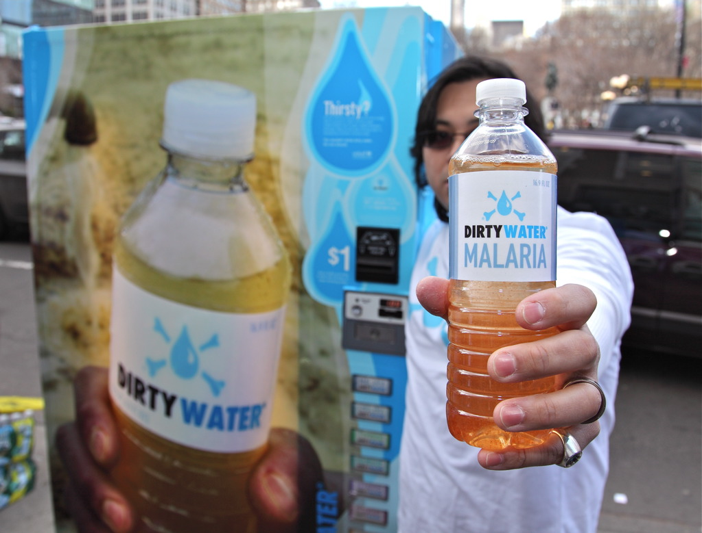
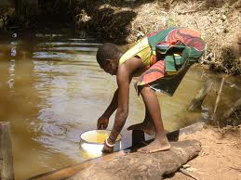
What “we” are doing wrong
In third world country's such as Pakistani community, we are taking water from them. This is causing the children and elderly to become sick from the dirty water that they (They as in Nestle bottled water) have left. “The water is not only very dirty, but the water level sank from 100 to 300 to 400 feet,” Dilwan says. So why do we take water from other countries? The reason is, is that we can tax the bottled water company's from using our own water but not for using other countries water. But the way I see it is that if humans need water to survive then water should be free. And we should use the water from our own lakes and aquifers and then we will see and realize that we need to take better care of our water. Therefore, we will use less water. (Even though it takes people to clean our water there's already a hidden tax for it so there will be no extra taxes).

Slide 4
My thoughts
There is 2 different things that I have noticed researching this and half of it wasn’t even from this class. In science we are learning about global warming. And since there is global warming all the ice bergs are melting away and that is clean fresh drinking water. Since that is melting there are floods in some areas, so if there were bottled water company's in those areas then there wouldn’t be that bad of floods. But that’s helping one problem. If the bottled water company's want to stay in business then they will have to move to the flooding areas and not stay here in the areas that they are in a drought. I don’t know how much it will cost and how good of an idea it is but in the theory I have it will help with the droughts. There is also a possibility that we could stop this global warming witch will bring us back to the same problems so in that conclusion I say water bottles are not the way, use recyclable bottles and properly dispose the water bottles that aren't recyclable.
Yet again that’s not about this assignment. But it does help, since there are no floods in the 3rd world countries then we should stop using there water and only use our water. Therefore, I think bottled water should be band.

